Slide 1

SOFTWARE TESTING
,

Slide 2
What is software testing:
Software Testing is a method to check whether the actual software product matches expected requirements and to ensure that software product is defect free.
The purpose of software testing is to identify errors, gaps or missing requirements in contrast to actual requirements.

Slide 3

why is software testing Is important?
Software Testing is Important because if there are any bugs or errors in the software, it can be identified early and can be solved before delivery of the software product.
Properly tested software product ensures:
reliability
security
high performance
results in time saving
cost effectiveness
customer satisfaction.

Slide 4
What are the benefits of Software Testing?
Here are the benefits of using software testing:
Cost-Effective: It is one of the important advantages of software testing. Testing any IT project on time helps you to save your money for the long term. In case if the bugs caught in the earlier stage of software testing, it costs less to fix.
Security: It is the most vulnerable and sensitive benefit of software testing. People are looking for trusted products. It helps in removing risks and problems earlier.
Product quality: It is an essential requirement of any software product. Testing ensures a quality product is delivered to customers.
Customer Satisfaction: The main aim of any product is to give satisfaction to their customers. UI/UX Testing ensures the best user experience.

Slide 5

REASONS OF SOFTWARE DEFECTS:
Let’s see what all reasons of introduction of Defects/Bugs in the code:
Miscommunication of requirements introduces error in code
Unrealistic time schedule for development
Lack of designing experience
Lack of coding practices experience
Human factors introduces errors in code
Lack of version control
Buggy third-party tools
Last minute changes in the requirement introduce error
Poor Software testing skill

Slide 6
Advantages of starting early testing:
In the requirement’s stage, testing project’s requirements can be a cost-effective & useful to avoid bugs afterward.
Completion of writing test cases early will help to fix the test cases if later changes in requirements.
You will get enough to quantify the problem’s scope.
Early preparation of test environment, thereby preventing any delays and unknown risks will have enough time to deal with.
Many times test team not get enough time to test the software application, so they have to squeeze the testing time which affects the Quality of the product. So one soluyion is to start testing early so test team will get enough time to test software application so need not to squeeze your testing time.
You may find that few items may not be tested, since they may not be impacted. This input can cut down on your Testing phase.

Slide 7
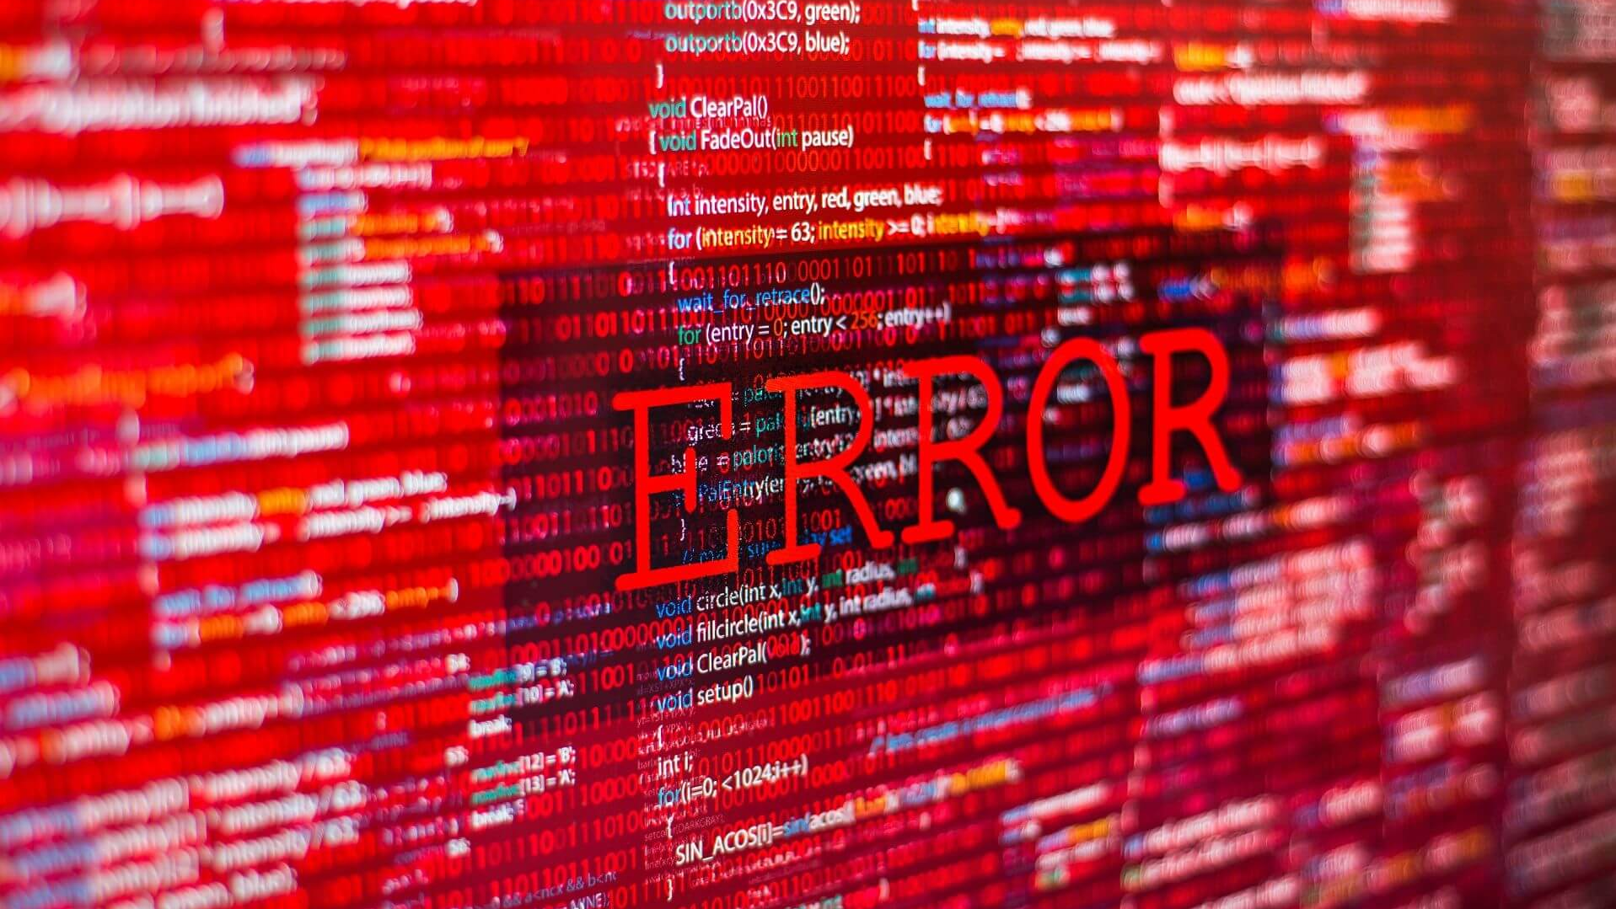
DIFFERENCE BETWEEN ERROR AND BUG:
In a testing process, identifying defects is often termed as "error". The error is a mistake, that result and reflects in coding. A bug is thereby caused by the error found in the developmental ecosystem.

Slide 8
TESTING AND QUALITY:
FOR A QUALITY PRODUCT THE FOLLOWING STEPS SHOULD BE TAKEN:
Testing should involve in all phases of SDLC.
Test planning should be started from beginning of the project.
Once the requirements are baselined, System testing plan ( or UAT ) and test cases should be prepared. This will also help in uncovering the gaps in requirements process.
Test preparation should be done before actual testing starts.
Start finding defects from requirement gather phase.
Keep on doing that throughout analysis and design phase.
As you move forward and complete the Design, you should complete the Integration testing
cases and also to some extent Unit test cases.
Ensure that testing becomes part of the development process.

Slide 9

Quality Assurance:
What Is Quality Assurance?
The quality assurance process helps a business ensure its products meet the quality standards set by the company or its industry. Another way to understand quality assurance (QA) is as a company’s process for improving the quality of its products.
Many businesses view their QA program as a promise to internal stakeholders and customers that the company will deliver high-quality products that provide a positive user experience.

Slide 10

7 Principles of Software Testing:
Testing shows presence of defects
Exhaustive testing is not possible
Early testing
Defect clustering
Pesticide paradox
Testing is context dependent
Absence of errors fallacy

Slide 11
ECONOMICS OF TESTING:
Software Economics -----in Software Engineering is mature research area that generally deals with most difficult and challenging problems and issues of valuing software and determining or estimation costs usually involved in its production.
The Economics of Testing there is a definite economic impact of software testing. One economic impact is from the cost of defects. This is a very real and very tangible cost. Another economic impact is from the way we perform testing. It is possible to have very good motivations and testing goals while testing in a very inefficient way
software economics principles can be applied to improve software design, development, and evolution.

Slide 12
THANK YOU

